Slide 1
WARM-UP

Slide 2
Watch the video and say something about it.
Do you think it is a meaningful video?
What lessons can you learn from it?

Slide 3
UNIT 3: FRIENDS

Slide 4
VOCABULARY

Slide 5
Blond hair (n)
/blɒnd heə/
Tóc vàng hoe.
She has blond hair.
Cô ấy có mái tóc vàng hoe.

Slide 6
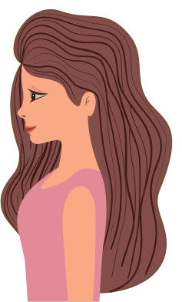
Long hair(n)
/lɒŋ heə /
Tóc dài
She has got long hair.
Cô ấy có mái tóc dài.

Slide 7
Short hair (n)
/ʃɔːt heə /
Tóc ngắn
My closed friend has got short hair.
Bạn thân của mình có mái tóc ngắn.

Slide 8
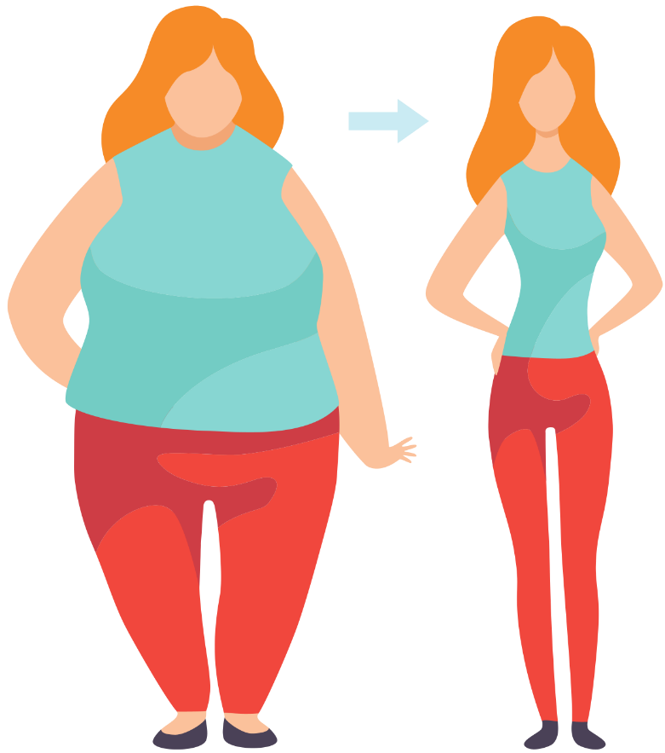
Slim (adj)
/slɪm/
Thon thả
Linh is slim. She is slimmer than her sister.
Linh thon thả. Cô ấy thon thả hơn là chị gái của cô ấy.

Slide 9
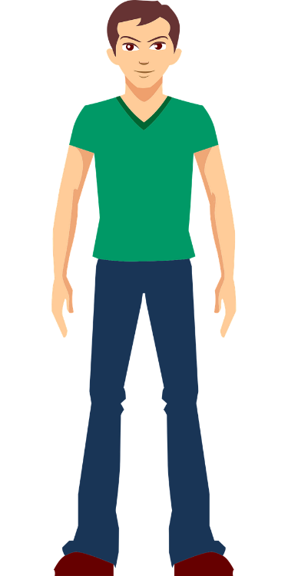
Tall(adj)
/tɔːl/
Cao
My father is very tall. He is taller than my mother.
Bố của tớ rất cao. Ông ấy cao hơn mẹ tớ.

Slide 10
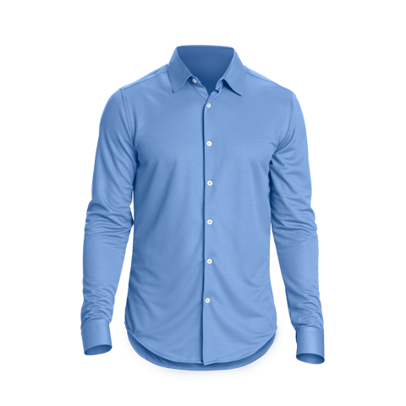
Blue Shirt (n)
/ bluː ʃɜːt/
Áo sơ mi xanh
He is wearing a blue shirt.
Anh ấy đang mặc 1 chiếc áo sơ mi màu xanh.

Slide 11
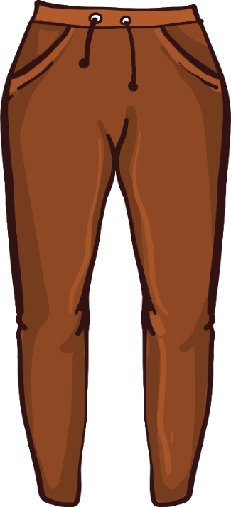
Brown pants (n)
/ braʊn pænts /
Quần âu màu nâu
She is wearing brown pants
Cô ấy đang mặc chiếc quần màu nâu.

Slide 12
Glasses (n)
/ˈglɑːsɪz/
Kính
John is wearing very nice glasses.
John đang đeo cặp kính đẹp

Slide 13
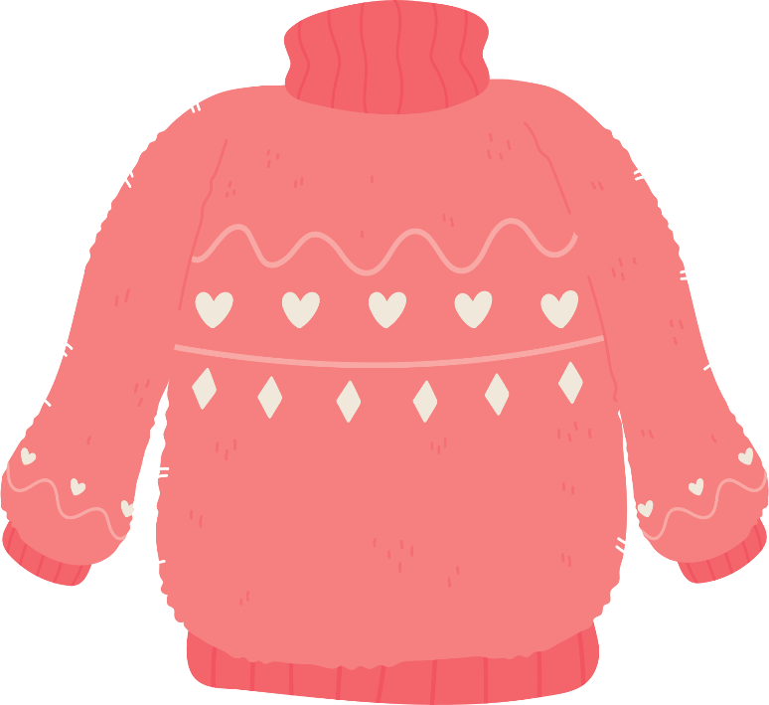
Pink sweater (n)
/ pɪŋk ˈswɛtər/
Áo len màu hồng
My baby sister is wearing a pink sweater.
Em gái mình đang mặc 1 chiếc áo len màu hồng.

Slide 14
Sneakers (n)
/ˈsniːkə(r)/
Giày thể thao
His sneakers are very cool.
Giày thể thao của cậu cấy nhìn rất ngầu.

Slide 15
Cap (n)
/kæp/
Mũ lưỡi trai
She likes wearing a cap on hot days.
Cô ấy thích đội mũ lưỡi trai vào các ngày nóng.

Slide 16
Striped T-shirt (n)
Áo phông kẻ sọc
He is wearing striped T-shirt and blue shorts
Anh ấy đang mặc áo phông kẻ sọc và quần ngố xanh.

Slide 17
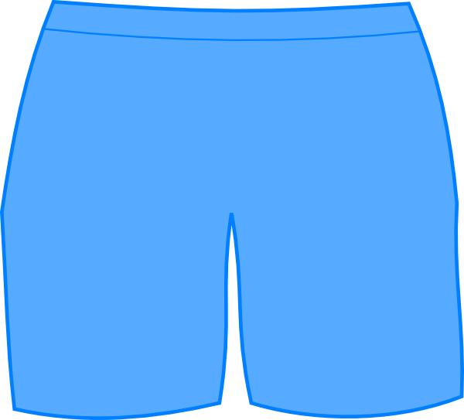
Shorts (n)
/ʃɔːts/
Quần sooc
They often wear shorts in summer.
Họ thường mặc quần sooc vào mùa hè.

Slide 18
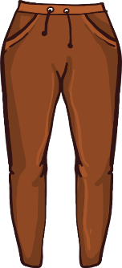
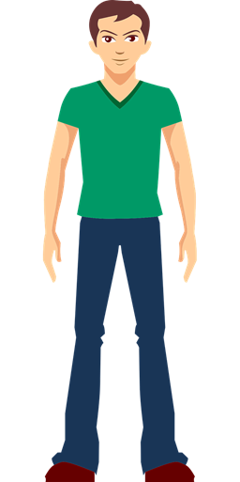
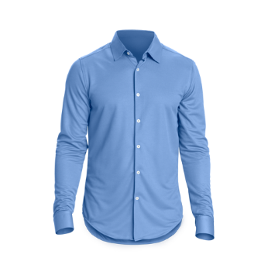
REVIEW
Blond hair
Short hair
Slim
Striped T-shirt
Brown pants
Long hair
Sneakers
Glasses
Tall
Pink sweater
shorts
Blue shirt

Slide 19
practice
Write the words in the table. Listen and repeat.
tall 2. blue 3. glasses 4. slim 5. red
6. blond 7. long 8. brown(x2) 9. short(x2)
body
hair
eyes
tall
short
brown
slim
blond
blue
short
long
glasses
brown
red
I am_____________
I am not__________
I have _______ hair/ eyes
I don’t have__________ hair/ eyes

Slide 20
WHEEL OF NAMES
https://wheelofnames.com/#
Introduce yourself using these words.
Example :
- Hello, everyone!
- Let’s me introduce about myself
- I am tall/short. I have long/short/brown/black hair , brown eyes/

Slide 21
a. Listen to a girl trying to find her friend at summer camp. Tick the person she is looking for
a. Now, listen and circle “ True” or “ False”
1. Mary is tall and has long blond hair.
True/False
2. Mary is wearing a striped T-shirt and blue shorts.
True/False
3. Jane has brown hair.
True/False
4. Jane isn’t wearing glasses.
True/False

Slide 22
Role play with your partner. Imagine you are finding your friend. You can change the underlined words.
Emma: Hey, Jake, have you seen my friend, Mary? Jake: Mary? Emma: Yeah, she's in my group. Jake: What does she look like? Emma: She's tall and has long blond hair. Jake: Is she wearing a striped T-shirt and red shorts? Emma: Yes, she is.
Jake: She went back to camp with Jane. Emma: Who? Jake: Jane Stephens. Emma: What does she look like? Jake: She's short and has short black hair. Emma: Is she wearing glasses? Jake: No, she isn't. Emma: I think I know who she is. Let's go back to camp. Jake: OK.

Slide 23
CONVERSTION SKILL
When you want to end a conversation in a friendly way , you often say
See you soon.
Talk to you later.
See you later
Take care
Catch you later
Peace out
Let’s practice to say goodbye to your friends and teacher.

Slide 24
WRAP-UP

Slide 25
ONLINE PRACTICE
https://wordwall.net/resource/20595766

Slide 26
HOMEWORK
- Learn by heart the new words.
- Practice describing someone’s personal appearance.
- Do exercises in Workbook: Lesson 1 - New words and Listening (page 14).
- Prepare: Lesson 1 - Grammar (page 23 - SB).

Slide 27
Find in your class who has / is long hair/short hair/glasses/tall/slim
Long hair
Short hair
glasses
tall
slim

Slide 28
GAME: bingo
Instruction: The teacher asks each students to draw a table with nine squares. In each square student will write a new words they have learnt randomly. The teacher calls out a word. If they have the word, they will cross on the table. Who make the first line will call out BINGO. Teachers will continue to find out some BINGOES if have enough time.

