Slide 1
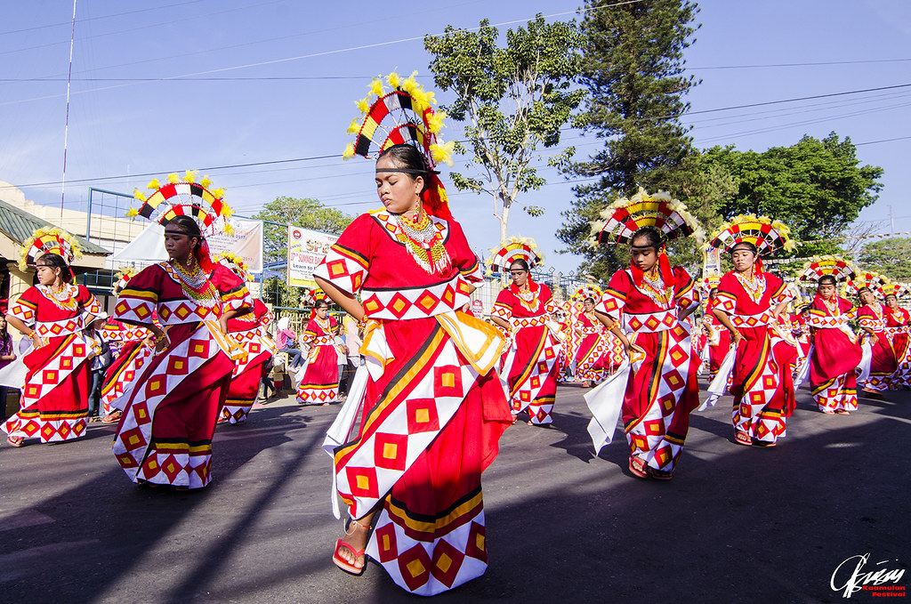
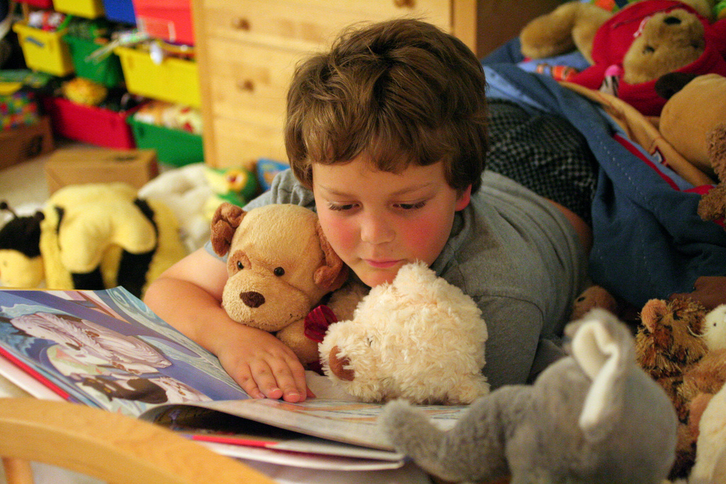
UNIT 4
Festivals &
Free time

Slide 2
LESSON 1

Slide 3
WARM UP

Slide 4
Listen to the song and answer the questions
1. When do people often sing the song?
ON NEW YEAR
2. Do you know the name of the band who sang the song?
ABBA

Slide 5
NEW WORDS

Slide 6
When do you do these activities? Put a tick
When do you …………….? | Mon | Tues | Wed | Thurs | Fri | Sat | Sun
1. go shopping
2. Listen to music
3. Ride a bike to school
4. Play computer games
5. Surf the internet

Slide 7
ADVERS OF FREQUENCY
always
1
often
usually
2
usually
Work in pair and put the adverbs of frequency to the correct position in the triangle.
often
3
never
sometimes
4
sometimes
rarely
5
rarely
never
6
always

Slide 8
ADVERS OF FREQUENCY
always
Luôn luôn
100%
usually
90%
Thường thường
often
Thường xuyên
70%
sometimes
50%
Thi thoảng
rarely
10%
Hiếm khi
never
Không bao giờ
0%

Slide 9
Fill in the blanks. Listen and repeat.
often never sometimes always rarely usually
Write the verbs after the adverb of frequency and practice with your partner.
I never watch movies.
4. _______
5. _______
6. ________
rarely
often
usually
always
1. __________
2. __________
3. ________
never
sometimes
__________
__________
__________
__________
__________
__________
watch movies

Slide 10
Circle the wheel and make a sentence with the adverbs.
usually
sometimes
often
never
Gợi ý: Khi giáo viên quay wheel dừng ở từ nào, học sinh sẽ phải nói một câu dung trạng từ tần xuất đó. Có thể chia lớp thành 2 đội và gọi theo cặp. Đội nào có bạn trả lời đúng và nhanh hơn đội đó đạt điểm.
Rarely
always
ften
usually
SPIN

Slide 11
LISTENING

Slide 12
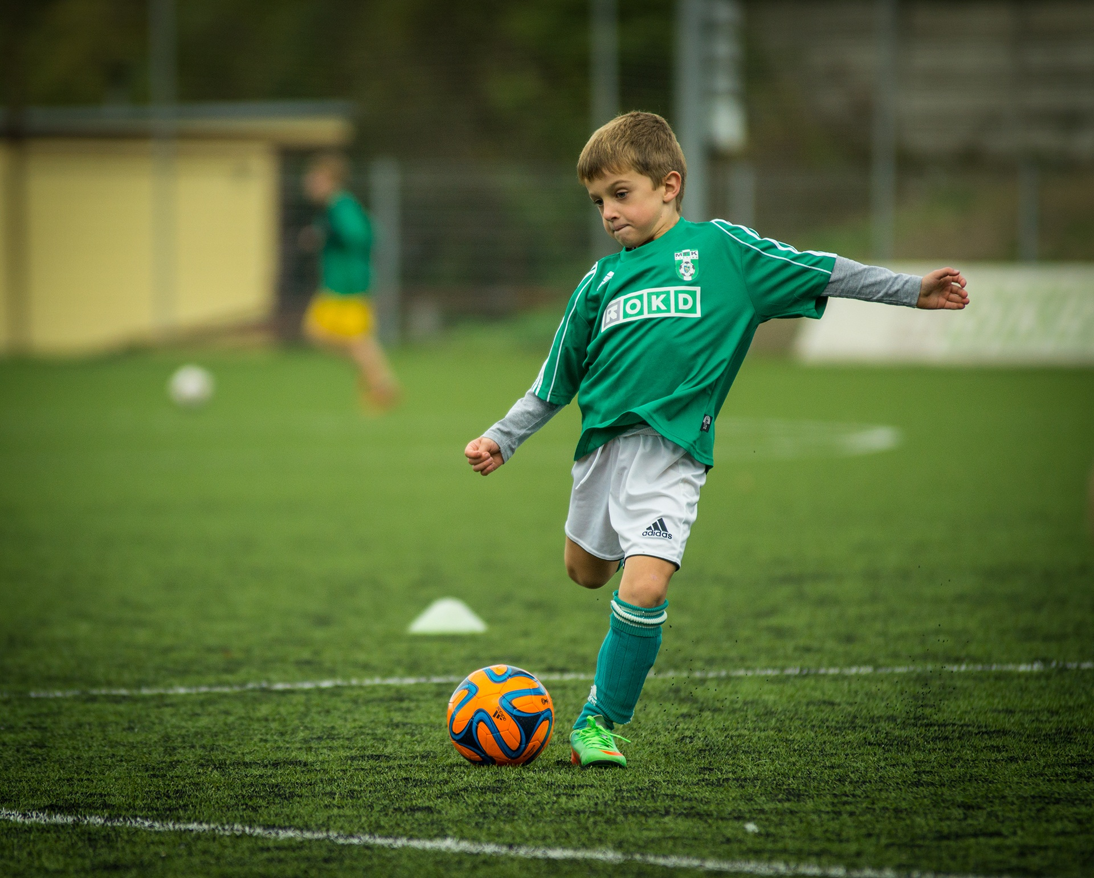
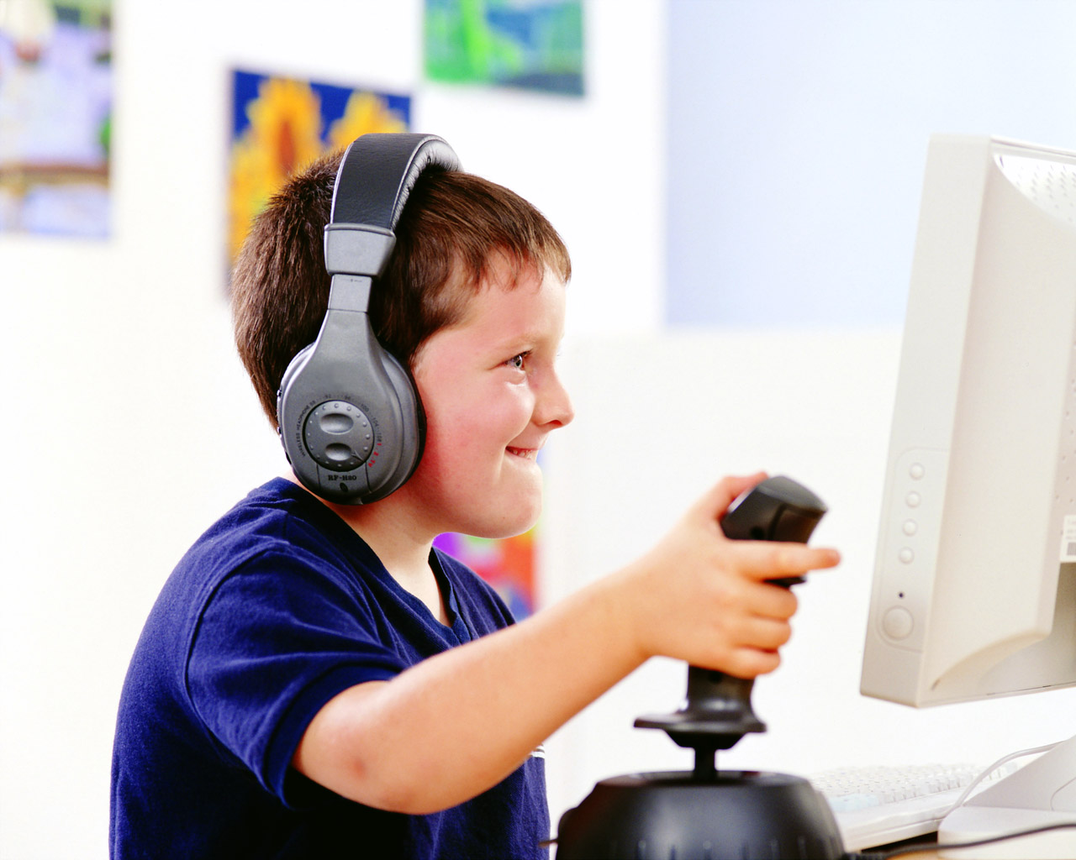
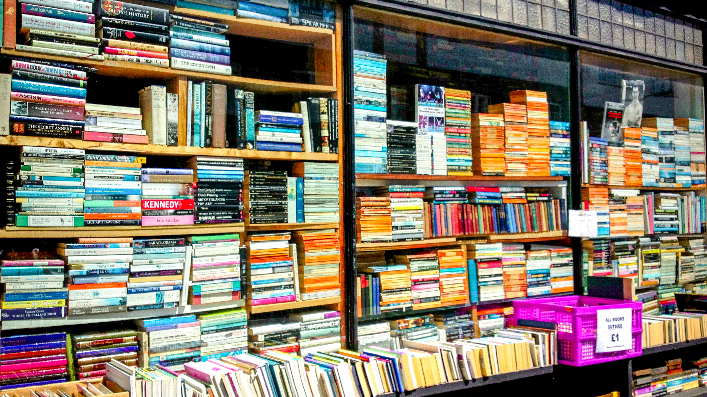
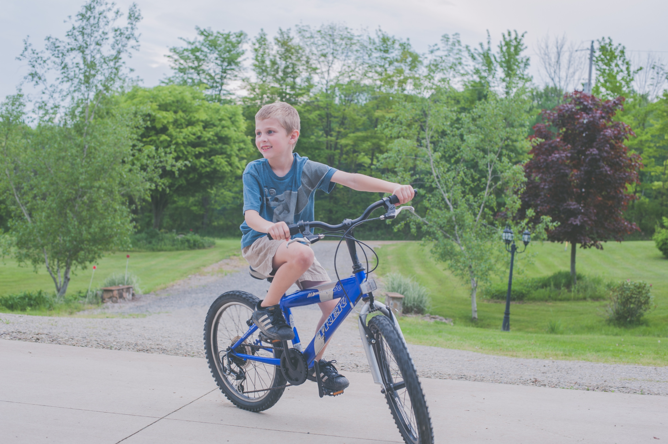
play soccer
play computer games
bookstore
read books
ride a bike

Slide 13
Listen to Lisa and Max talking about free time activities.
Does Max like reading?
Now, listen and fill in the blanks.
1. Lisa __________________goes to the bookstore on Fridays
always
2. Max ______________ plays video games when he gets home from school
3. Max __________________ plays soccer on the weekends.
4. Lisa ________________ride her bike on Saturdays.
usually
often
sometimes

Slide 14
Listen again and fill in the blanks. Then practice with your partner.
Max: Hi, Lisa. Where are you going? Lisa: I'm going to the bookstore. Do you (1)________ to come? Max: Oh, no, thanks. I can't today. Lisa: How about next week? I always go there on Fridays. Max: Mmm, maybe. I (2)_____ go to the bookstore. Lisa: Really? I love reading! Don't you? Max: Not really. Lisa: So, what do you like doing?
Max: I love playing video games. Lisa: How (3)_____ do you play them? Max: I usually play them after school. Lisa: What about on the weekends? What do you do then? Max: I often go to the (4)______to play soccer. Lisa: Nice, I (5)___________ride my bike at the park on Saturdays. Maybe I'll see you there! Max: Great!
often
want
park
never
sometimes

Slide 15
WORD | CLASS | MEANING
never
adv
không bao giờ
rarely
adv
hiếm khi
sometimes
adv
thỉnh thoảng
often
adv
thường xuyên
usually
adv
thường thường
always
adv
luôn luôn
play soccer
chơi đá bóng
v

Slide 16
WORD | CLASS | MEANING
ride a bike
v
lái xe đạp
read books
v
đọc sách
play computer games
adv
chơi điện tử
book store
n
Hiệu sách

Slide 17
WRAP-UP
* Adverbs of frequency: Always, usually, often, sometimes, rarely, never

Slide 18
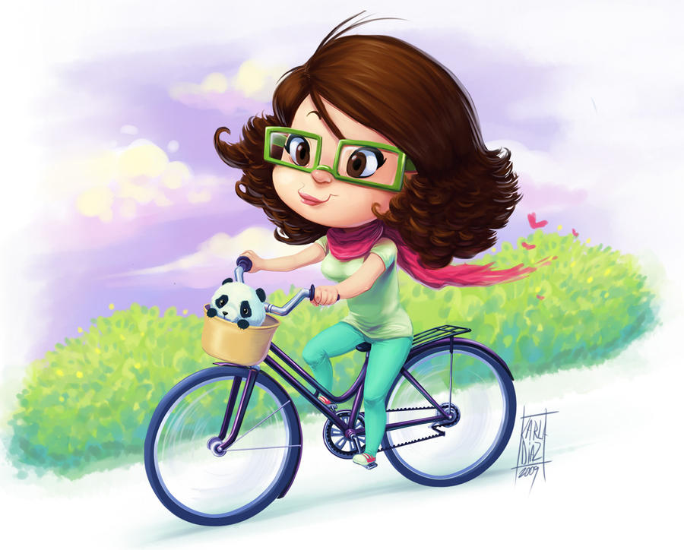
1. I ride my bike twice a week.
I ___________ ride my bike
always
usually
often
sometimes
rarely
never

Slide 19
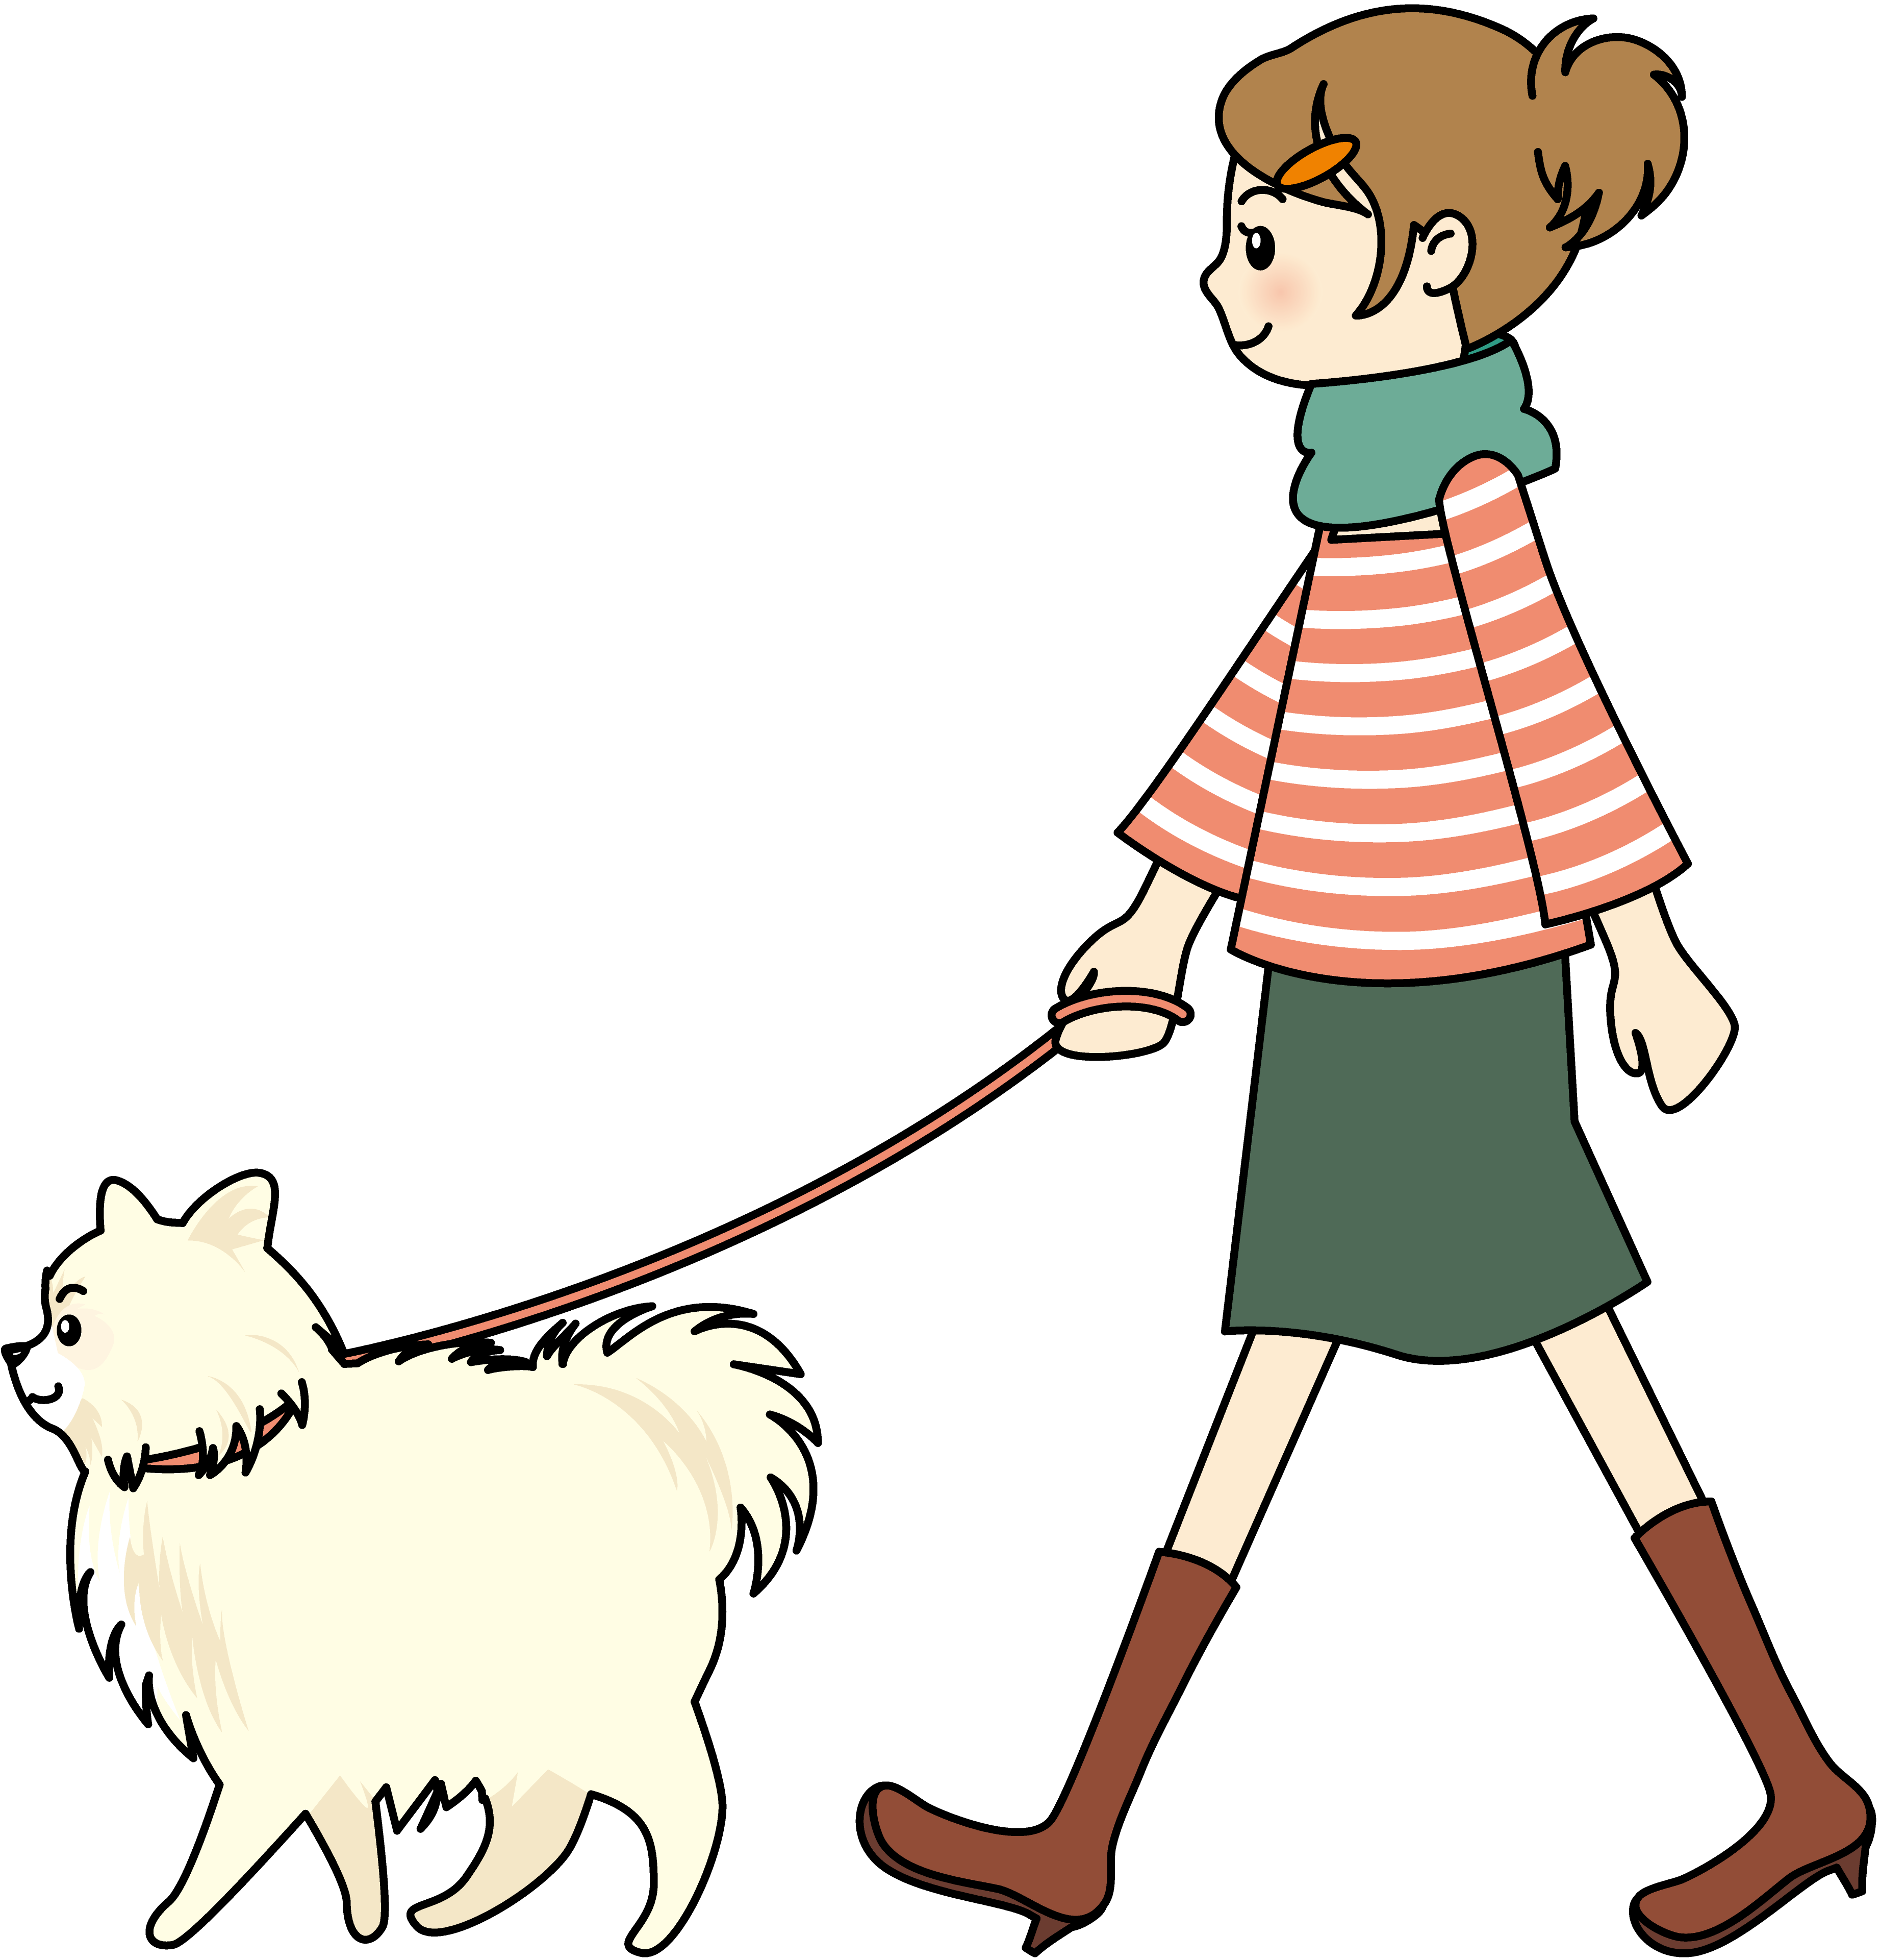
2. I walk my dog everyday.
I _______ walk my dog.
always
usually
often
sometimes
rarely
never

Slide 20
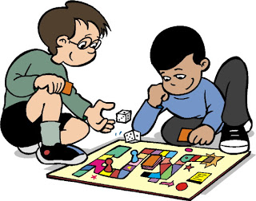
3. I play board game
five times a week.
I __________ play it.
always
usually
often
sometimes
rarely
never

Slide 21
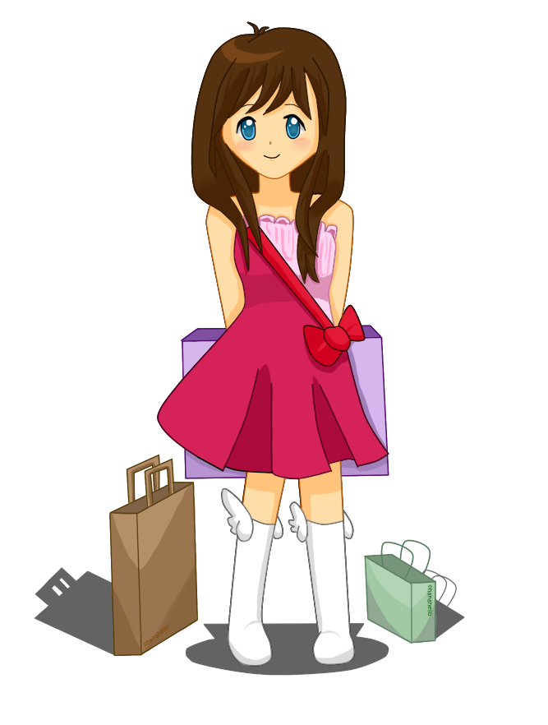
4. I go shopping once a month.
I _____________ go to the cinema.
always
usually
often
sometimes
rarely
never

Slide 22
5. I don’t drink coffee.
I _______ drink coffee
always
usually
often
sometimes
rarely
never

Slide 23
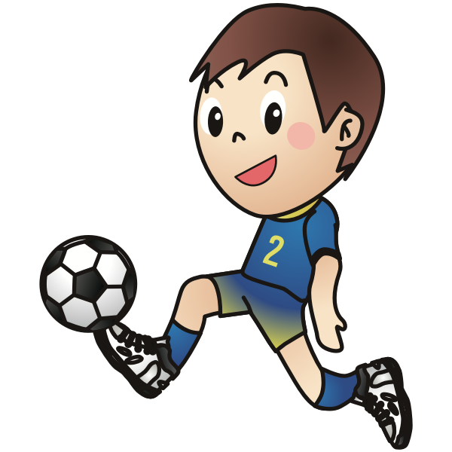
6. I play soccer once a week.
I _____________ play basketball.
always
usually
often
sometimes
rarely
never

Slide 24
HOMEWORK
Learn by heart the adverbs of frequency
Make sentences with at least 3 adverbs of frequency.
- Do exercises in Workbook: Lesson 1 - New words (page 20).
- Prepare: Lesson 1 – Grammar (page 31 – SB).

