Slide 1
UNIT 5
AROUND TOWN

Slide 2
LESSON 1

Slide 3
WARM-UP
WARM UP
Listen to the song and list the kinds of clothes you can see

Slide 5
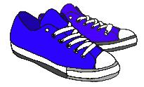
hat
shoes
scarf
Jacket

Slide 6
NEW WORDS

Slide 7
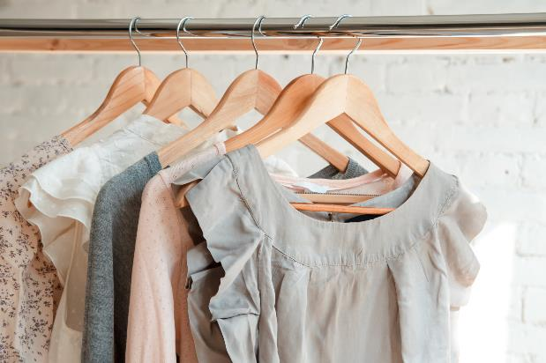
clothes
/kləʊðz/
Quần áo
You should wear warm clothes in winter.
Bạn nên mặc quần áo ấm vào mùa đông.

Slide 8
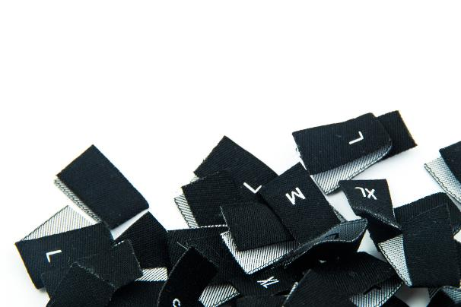
size
/saɪz/
kích cỡ
Do you have the dress in small size?
Bạn có cái váy này cỡ nhỏ không?

Slide 9
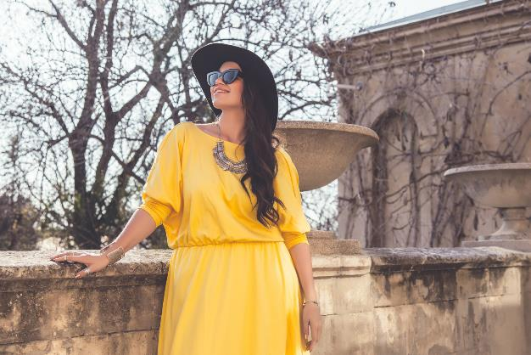
large
/lɑːdʒ/
lớn
I want to try on the trousers in large size.
Tôi muốn mặc thử cái quần này ở cỡ lớn

Slide 10
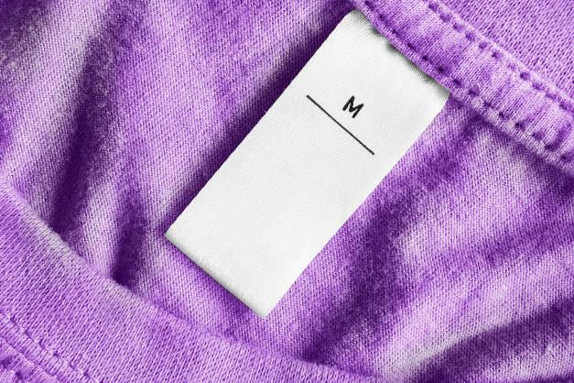
medium
/ˈmiːdiəm/
Trung bình
We only have the sweater in the medium size.
Chúng tôi chỉ có chiếc áo len này cỡ trung bình.

Slide 11
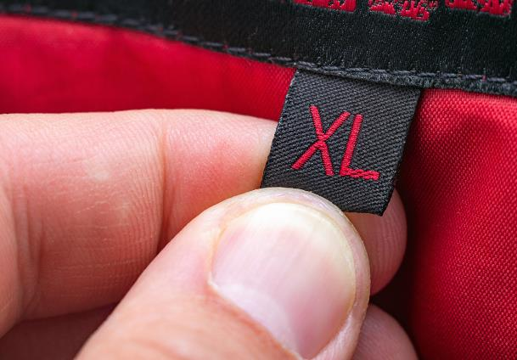
extra large
/ˈɛkstrə lɑːʤ/
ngoại cỡ
My mother is a bit over weight, so I want to buy an extra large blouse for her.
Mẹ tôi hơn thừa cân nên tôi muốn mua một chiếc áo ngoại cỡ cho mẹ.

Slide 12
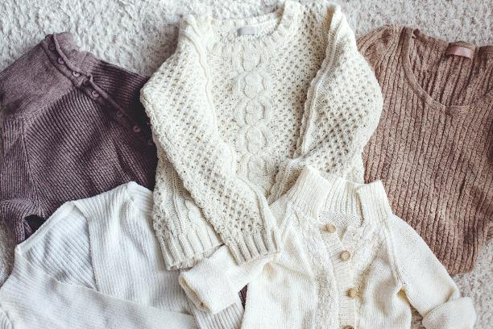
sweater
/ˈswɛtə/
áo len
These sweaters are so trendy in this winter.
Những chiếc áo len này rất hợp xu thế trong mùa đông này.

Slide 13
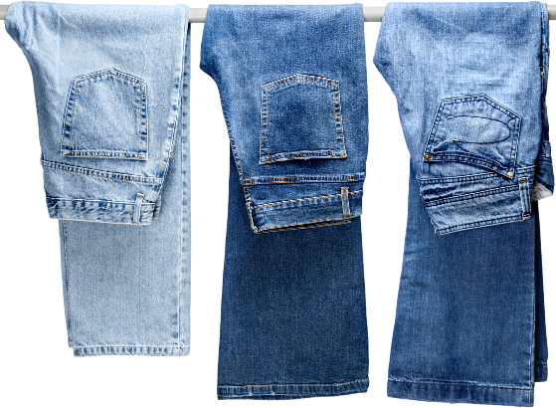
jeans
/ʤiːnz/
Quần bò
You look so active in the blue jeans !
Bạn nhìn rất năng động trong chiếc quần jeans màu xanh.

Slide 14
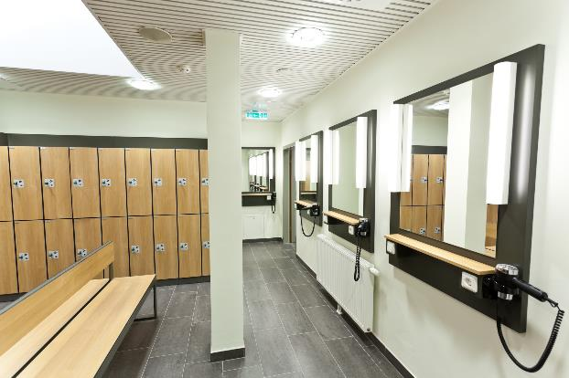
changing room
/ˈʧeɪnʤɪŋ ruːm/
Phòng thay đồ
Is there any changing room here?
Có phòng thay đồ nào ở đây không?

Slide 15
sale assistant
/seɪl əˈsɪstənt/
Nhân viên bán hàng
The sale assistant in this shop is so friendly.
Người bán hang ở cửa hang này rất thân thiện.

Slide 16
customer
ˈkʌstəmə
Khách hàng
The customers are choosing their suitable clothes.
Những người mua hang đang chọn những loại quần áo phù hợp với họ.

Slide 17
MEMORY GAME
Student can look at the pictures 2 minutes and remember the position of the words.
Teacher call randomly to choose the number and say the words loudly.

Slide 18
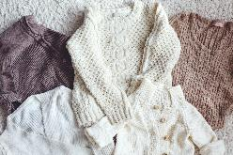
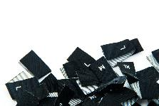
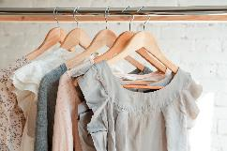
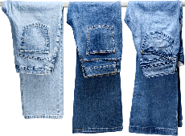
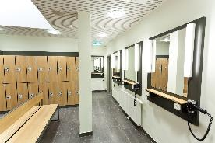
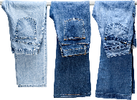
1
2
3
4
5
6
7
8
9
10
11
12

Slide 19
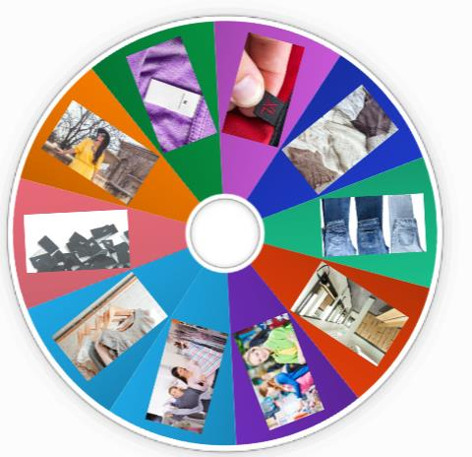
https://wordwall.net/resource/21636729
ONLINE PRACTICE
Click here

Slide 20
New word
a. Fill in the table. Listen and repeat.
large 2. extra large 3. jeans 4. medium
5. changing room 6. sweater 7. customer 8. sales assistant
clothes
size
others
jeans
large
changing room
customer
sweater
extra large
sale assistant
medium

Slide 21
LISTENING

Slide 22
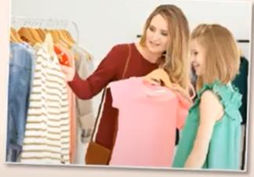
a. Listen to Cassie talking to her mom in a clothing store. Do they buy any clothes? Yes/No
b. Now, listen and circle “ True” or “ False”
True/False
1. The pink T-shirt is small.
2. Cassie’s mom buys a sweater.
True/False
3. The sweater is seven dollars
True/False
4. Cassie’s mom buys her a black T-shirt
True/False

Slide 23
Role play to practice the conversation.
Mom: Cassie, look. I like this sweater. Cassie: Oh that's nice, Mom. What about this pink T-shirt? Do you like it? Mom: It looks great. Sales assistant: Hi, can I help you? Cassie: Yes, please. Do you have this pink T-shirt in a small? Sales assistant: Let me check. I'm sorry, we only have a small in black. Cassie: Oh…
Sales assistant: Here it is. Do you want to try it on? Cassie: Hmm,…OK. Where's the changing room?
Sales assistant: It's just over there.
Cassie: Thanks. Mom: How much is this sweater? Sales assistant: It's ffteen dollars. Mom: That's fne. I'll take it. Cassie: Mom, look! Mom: You look great. How much is the T-shirt? Sales assistant: It's seven dollars. Mom: I'll take that, too.

Slide 24
CONVERSATION SKILL

Slide 25
Để bắt đầu đoạn hội thoại để giúp đỡ một ai đó bạn không biết bạn thường nói :
hi, can I help you?
Hello, do you need any help?
You can say:
Do you have this ......?
in medium?
in a medium?
In a medium size?

Slide 26
Role play to practice the conversation with your partner.
you can change the yellow words
Sale assistant:Excuse me!
Sale assistant:Do you need any help?
Customer: Do you have this in large size?

Slide 27
WRAP-UP

Slide 28
WORD | CLASS | MEANING
adj
lớn
large
extra large
adj
ngoại cỡ
jeans
n
quần bò
n
phòng thay đồ
changing room
medium
adj
cỡ vừa
sweater
n
áo len
customer
n
khách hàng

Slide 29
WORD | CLASS | MEANING
size
N
cỡ
clothes
N
quần áo
Phra
Bạn có cần giúp đỡ gì không?
Do you need any help?

Slide 30
HOMEWORK
- Learn by heart the new vocabularies.
- Practice talking about clothes, sizes and prices.
- Do exercises in Workbook: Lesson 1 - New words and Listening (page 26).
- Prepare: Lesson 1 – Grammar (page 39 – SB).

