Slide 2
LESSON 2

Slide 3
WARM UP
Let’s watch the film trailer and do you know the name of the film?
2. In your opinion, what’s the film like?

Slide 4
NEW WORDS:

Slide 5
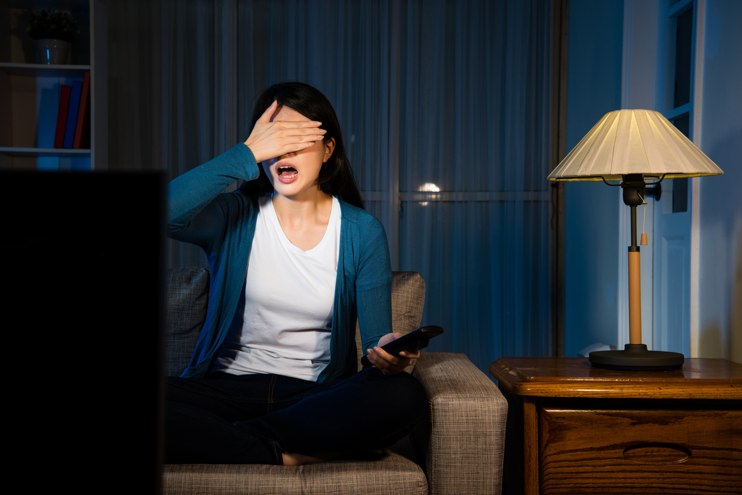
terrible
/ˈterəbl/
(adj) tồi tệ
I don’t want to see the film again. It is terrible!
Tôi không muốn xem bộ phim này nữa. Nó rất tệ.

Slide 6
fantastic
/fænˈtæstɪk/
(adj) tuyệt vời
This action movie is so fantastic.
Bộ phim hành động này rất tuyệt vời.

Slide 7
sad
/sæd/
(adj) buồn
I cried alot because of the sad ending of the film.
Tôi đã khóc bởi vì kết cục buồn của bộ phim này.

Slide 8
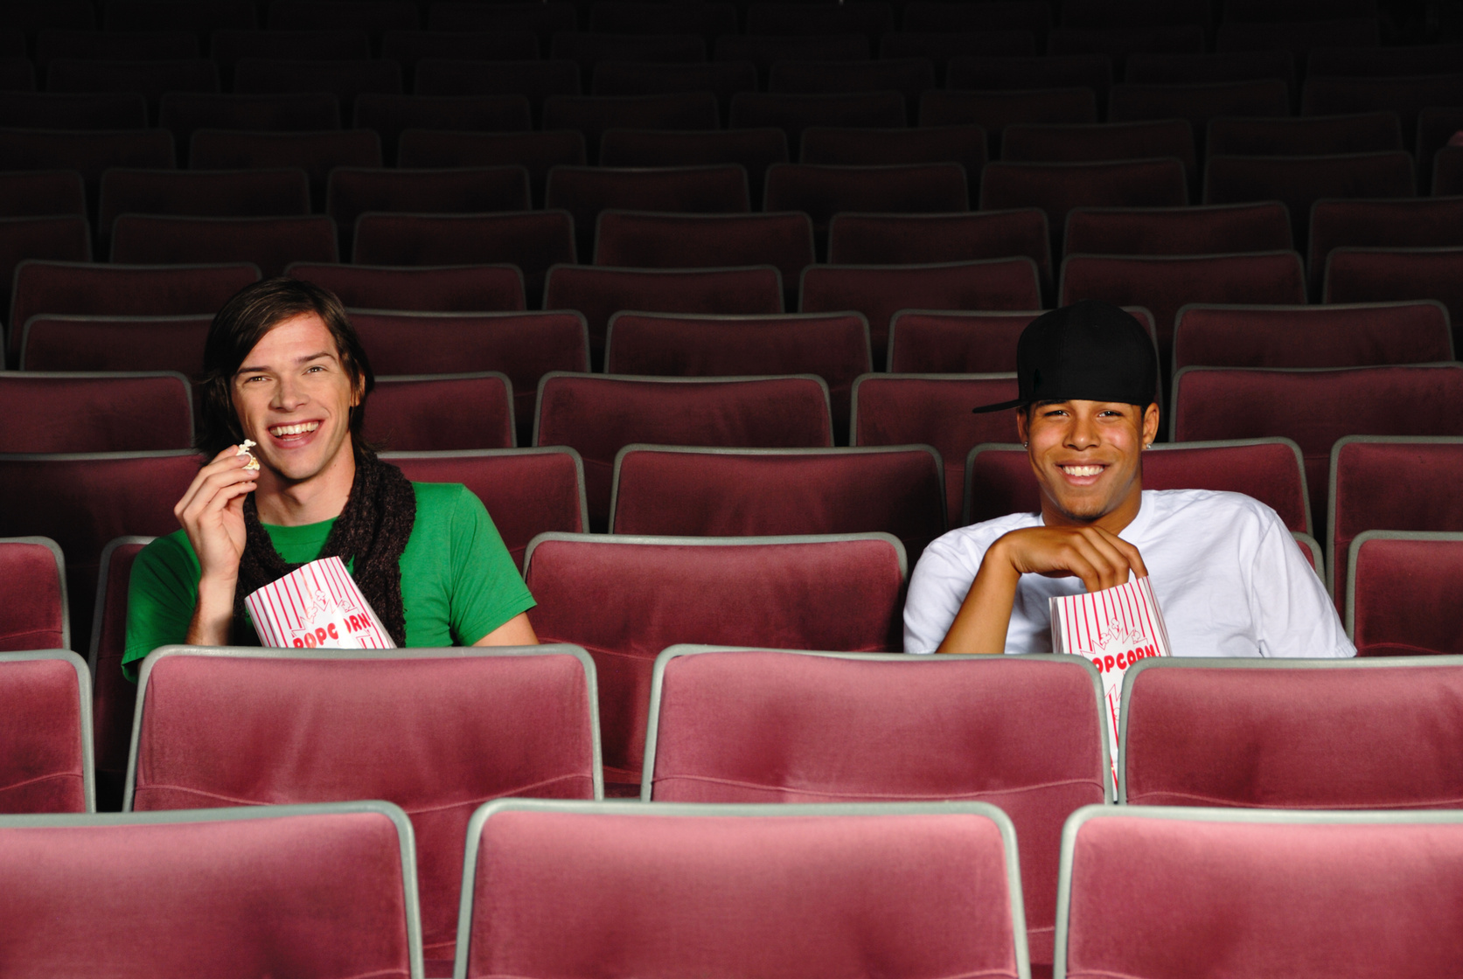
funny
/ˈfʌni/
(adj) vui vẻ, hài hước
They laughed alot because the main actor was very funny.
Họ cười rất nhiều bởi vì diễn viên nam chính rất hài hước.

Slide 9
boring
/ˈbɔːrɪŋ/
(adj) nhàm chán
The film was so boring that I turned off the TV.
Bộ phim này nhàm chán đến nỗi mà tôi đã tắt ti vi.

Slide 10
exciting
/ɪkˈsaɪtɪŋ/
(adj) thú vị
The children were so exciting when they saw the movie.
Những đứa trẻ rất hào hứng khi chúng xem bộ phim này.

Slide 11
great
/ɡreɪt/
(adj) tuyệt
It’s great to see my favorite actor on TV.
Thật tuyệt khi nhìn thấy diễn viên yêu thích của tôi trên ti vi.

Slide 12
awful
/ˈɔːfl/
(adj) kinh khủng
It was awful when I heard the bad news.
Thật kinh khủng khi tôi đã nghe thấy tin xấu buồn đó.

Slide 13
1
5
fantastic
sad
2
6
boring
funny
3
terrible
7
exciting
4
awful
8
great

Slide 14
New words
a. Fill in the blanks with the opposite adjectives. Listen and repeat!
fantastic
funny
great
exciting
terrible
sad
______
______
awful
boring
______
______
fantastic
great
funny
exciting
b. Talk about kinds of movie you like and don’t like using the adjectives.

Slide 15
Complete the table about yourself.
b. Talk about kinds of movie you like and don’t like using the adjectives.
KINDS OF MOVIE | LIKE DISLIKE | WHY
horror movie |  | scary/boring/awful
drama |  | ...................................................
animated movie |  | ..................................................
science fiction |  | ...................................................
action movie |  | .................................................

Slide 16
a. Tina wrote two movie reviews for her blog. Underlined the correct final sentences.
Reading
Picture Day
I watched Picture Day yesterday. It was a very sad drama about two sisters. There was no action or adventure in this movie. The story was boring. The sisters just talked all the time. I usually like dramas, but this was terrible. Don’t watch this movie!/This was a great movie!
Sally’s travel
I saw Sally’s Travels last week. I don’t always like action movies, but this was fantastic! The story showed the hero, Sally , traveling in Australia and it was very, very exciting! Sally was very funny. She fell in the river and I laughed so much. This was terrible/What a fantastic movie!

Slide 17
b. Read the review again and answer the questions.
Picture Day
I watched Picture Day yesterday. It was a very sad drama about two sisters. There was no action or adventure in this movie. The story was boring. The sisters just talked all the time. I usually like dramas, but this was terrible. Don’t watch this movie!/This was a great movie!
What kind of movie was Picture Day?
What did Tina think about the story?
What kind of movie was Sally’s travels?
What did Tina think about the story?
What did Tina think about Sally?
- a sad drama
- It’s was boring
Sally’s travel
I saw Sally’s Travels last week. I don’t always like action movies, but this was fantastic! The story showed the hero, Sally , traveling in Australia and it was very, very exciting! Sally was very funny. She fell in the river and I laughed so much. This was terrible/What a fantastic movie!
- an action movie
- It’s was exciting
- She was very funny

Slide 18
Work in pair. Read the sentences and decide they talk about “ Picture Day” or “ Sally’s travel”
1. It was unhappy drama about two sisters.
Picture Day
2. The story showed the hero.
Sally’s travel
3. A girl fell into the river.
Sally’s travel
5. The movie had no adventure.
Picture Day
4. The movie was very fantastic.
Sally’s travel

Slide 19
WRAP-UP

Slide 20
Unit 7
MOVIE
Lesson 2: New words
funny (adj) buồn cười, vui nhộn
sad (adj) buồn
terrible (adj): tồi tệ
fantastic (adj): tuyệt vời
awful (adj) : kinh khủng
boring (adj) : tẻ nhạt, nhàm chán
exciting (adj): thú vị, thích thú

Slide 21
Extra activity:
Work in pair and finish the word search.
Online:
Click the icon and choose “ word search” icon on wordwall.net
This Photo by Unknown Author is licensed under CC BY-SA-NC

Slide 22
HOMEWORK
- New lesson: adjectives used to express/ describe movies.
- Talk about kinds of movies you like and don't like using the adjectives.
- Do exercises a, b, c on page 40 in the workbook.
- Prepare for the next lesson: Grammar (page 58)

