Slide 1
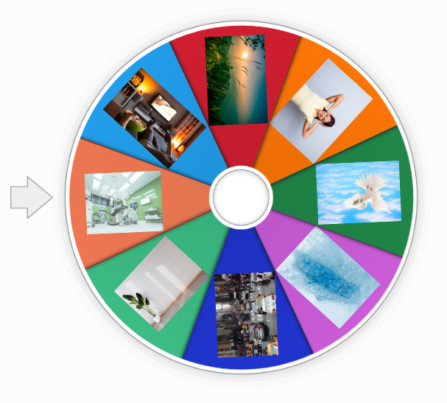

Click the circle and guess the words.
ONLINE GAME

Slide 2


Slide 3



LESSON 1
GRAMMAR

Slide 4
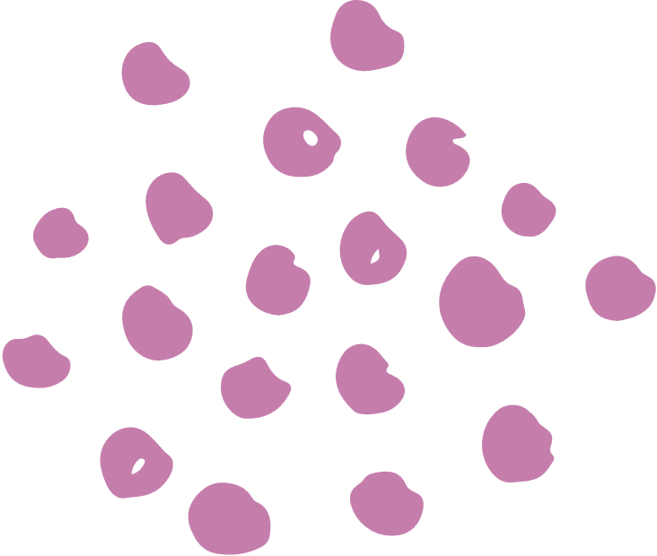









Click the best answer.
Countable
Uncountable
nature

Slide 5
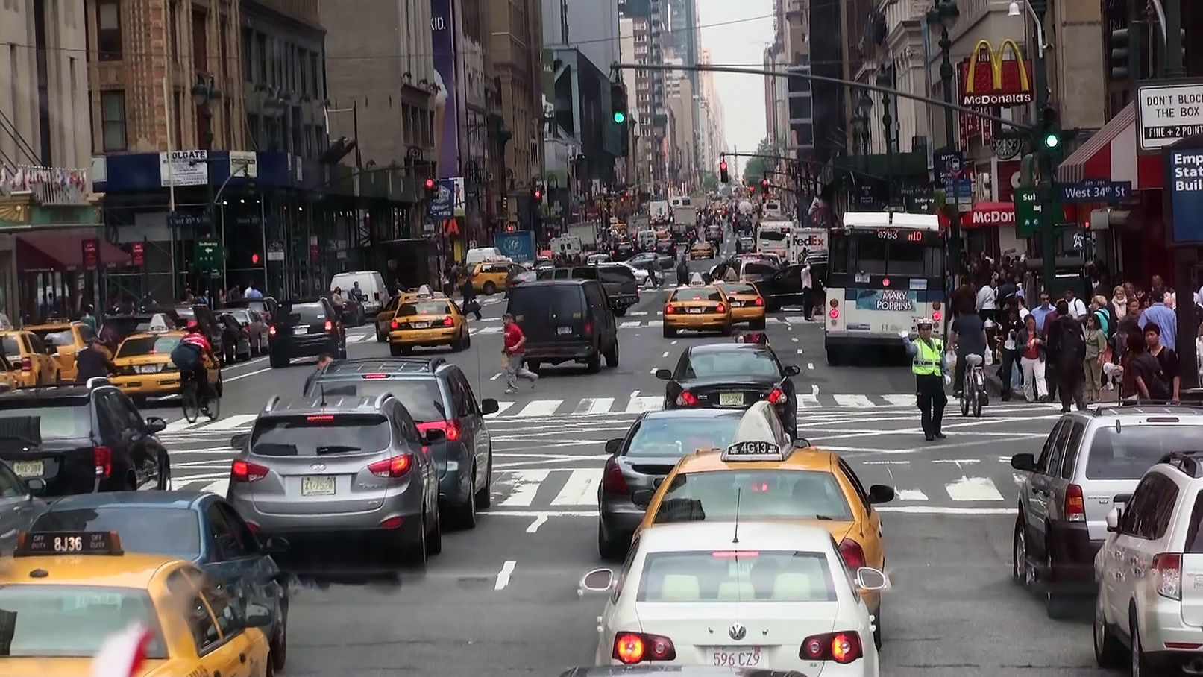
Click the best answer.
Countable
Uncountable
vehicle

Slide 6

Click the best answer.
Countable
Uncountable
entertainment

Slide 7

Click the best answer.
Countable
Uncountable
pollution

Slide 8

Click the best answer.
Countable
Uncountable
peace

Slide 9

Click the best answer.
Countable
Uncountable
facility

Slide 10

Click the best answer.
Countable
Uncountable
People

Slide 11





Welldone!
Do you have any questions for us?
End

Slide 12



COMMON UNCOUNTABLE NOUNS
food
liquid
others
butter
orange juice
money
cheese
coffee
homework
meat
milk
advice
rice
water
information
sugar
oil
bread
lemondade

Slide 13
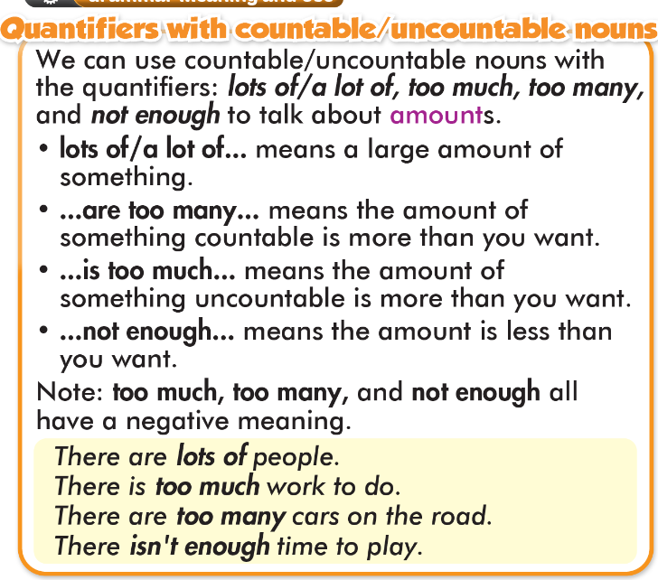

Slide 14

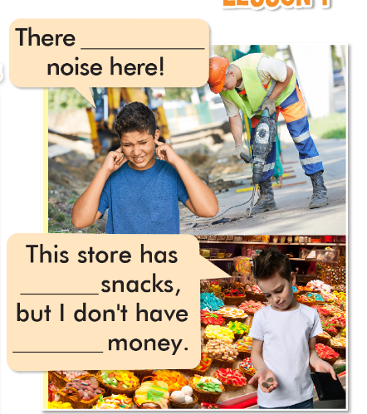
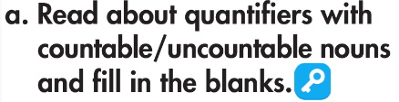

is too much
lots of
enough

Slide 15
a little/not much
a lot of, lots of
too much
too many
not enough
Một ít
Nhiều
Quá nhiều
Không đủ
Đứng trước danh từ không đếm được
Đứng trước danh từ số nhiều cả đếm được và không đếm được, câu khẳng định
He eats too many sweets.
I don’t have enough money to live.
a little water
too many + N(đếm được)
any tables
I have lots of friends.
I don’t have too much time to relax.
too much + N(không đếm được)
Mang nghĩa tiêu cực ( negative meaning)
Mang nghĩa tiêu cực ( negative meaning)

Slide 16
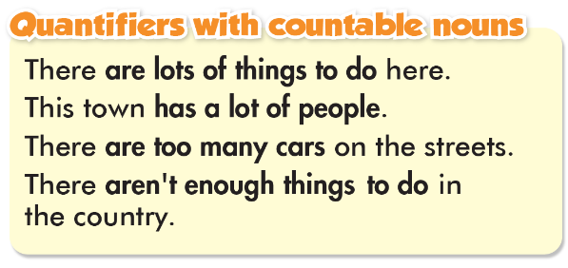
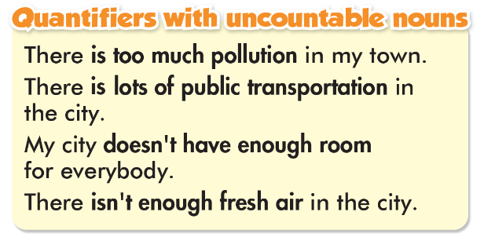

Slide 17

1. There are too much/many vehicles on the road.
2. There aren't/isn't enough facilities in this village.
3. There is/are too much noise in my town.
4. This city doesn't have enough/many fresh air.
5. There isn't enough things to do/entertainment here.
6. There is lots of nature/vehicles here in the country.

Slide 18

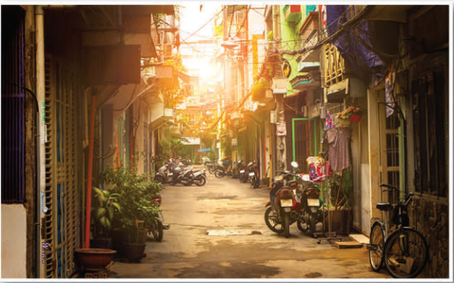
1. There/lots/peace and quiet/my village
_____________________________________________
2. My town/not/have/enough/entertainment
_____________________________________________
3. This city/have/much/pollution
_____________________________________________
4. There/many/vehicles/my street
_____________________________________________
5. There/lot/room/people/play/my city
_____________________________________________
6. There/not/many/things/do/my village
_________________________________________
There is lots of peace and quiet in my village.
My town doesn't have enough entertainment.
This city has too much pollution.
There are too many vehicles in/on my street.
There is a lot of room for people to play in my city.
There aren't many things to do in my village.

Slide 19
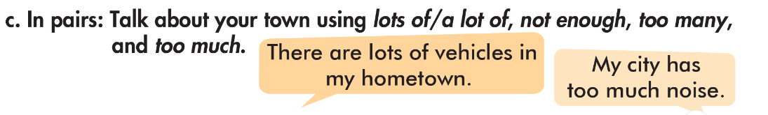


Slide 20

Write four sentences about your town/city using lots of/ a lot of, not enough, too many, too much.

Slide 21
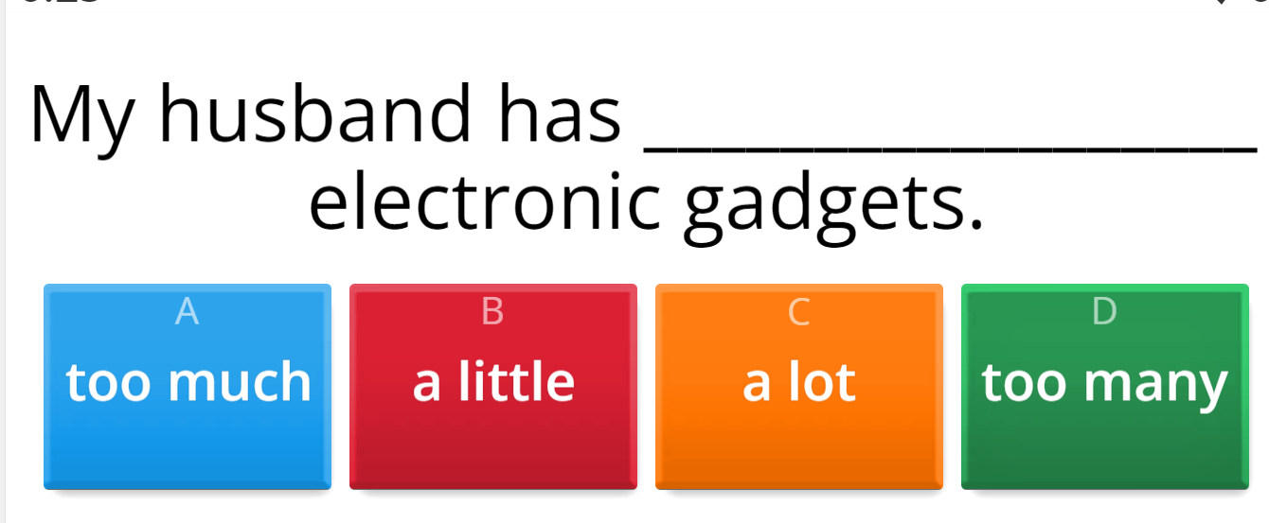
ONLINE GAME

Slide 22
WARP-UP
Unit 2
LIFE IN THE COUNTRY
Lesson 1: GRAMMAR
Grammar
Quantifiers with countable and uncountable nouns
Speaking
Talking about life in the city and in the country.

Slide 23

HOMEWORK
1. Learn by hearts the grammar point and make sentences using it.
2. Do the exercises in Tiếng Anh 8 i-Learn Smart World Notebook on page 14.
3. Prepare the next lesson (pages 16 & 17 SB)

Slide 24


