Slide 2
Look at the picture and choose the correct words.
ONLINE GAME

Slide 3
PRONUNCIATION
LESSON 2
SPEAKING

Slide 5
Watch the videos and work in pair to discuss about the safety plan for disasters.

Slide 6
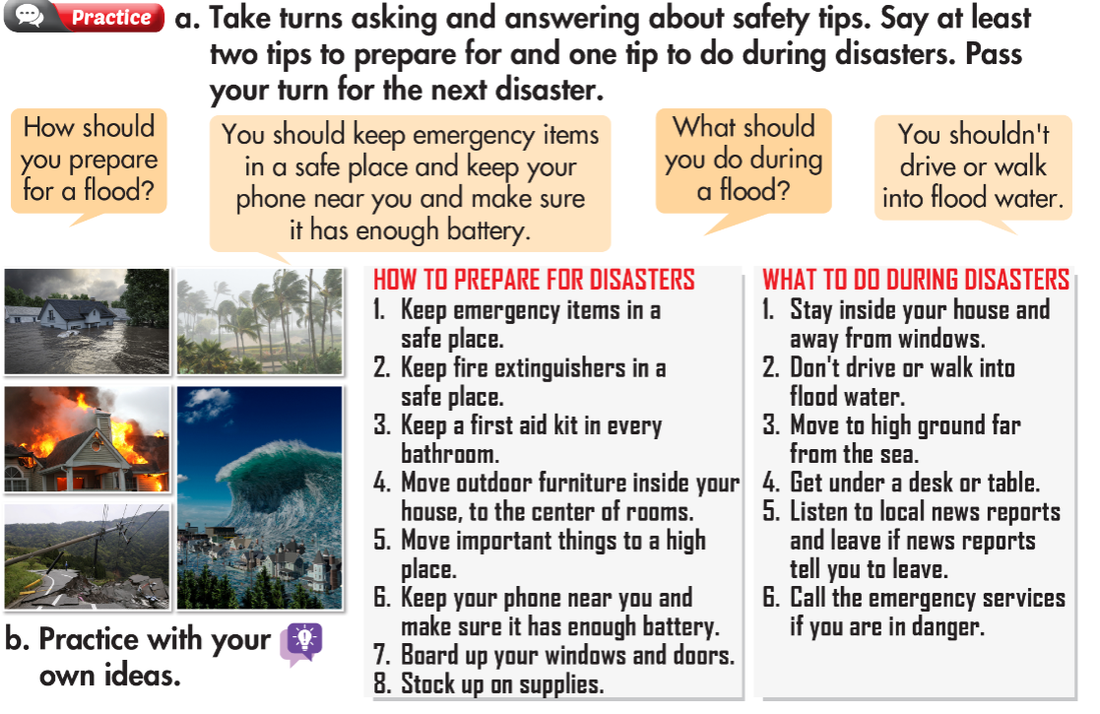

Slide 7
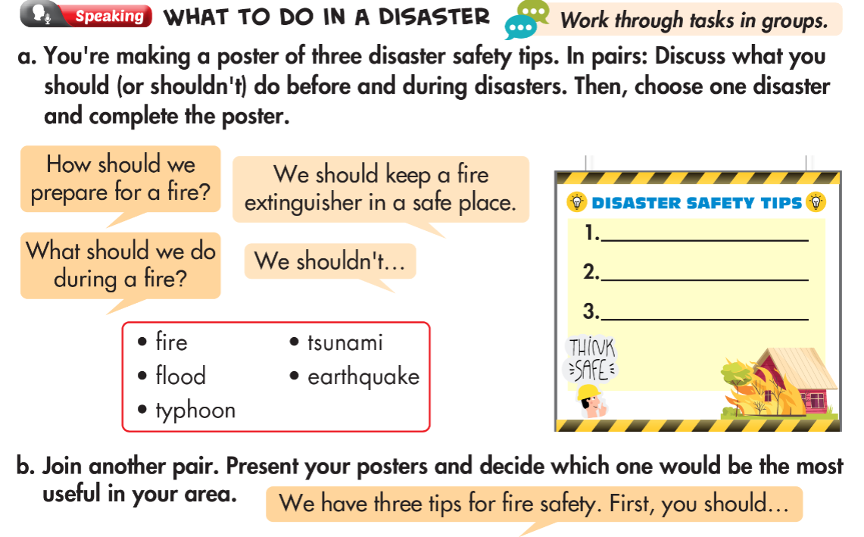

Slide 8
Gather Important Information:
Communication Plan
Family emergency plan
Escape Plan
Prepare emergency kit
Stay informed
Emergency contact

Slide 9
WARP-UP
Unit 4
DISASTERS
Lesson 6: Pronunciation & Speaking
Ms Phương
Zalo: 0966765064
Practice sentence stress
Give advice on what to do in a disaster, using: - prepositions of place and movement - conversation skill - Working through tasks in groups

Slide 10
Homework
Review: - Prepositions of place and movement. - Advice on what to do in a disaster.
Do the exercises on page 23 WB.
Do the exercises in Tiếng Anh 8 i-Learn Smart World Notebook on pages 33.
Prepare the next lesson (pages 42-43, SB)

