Slide 1

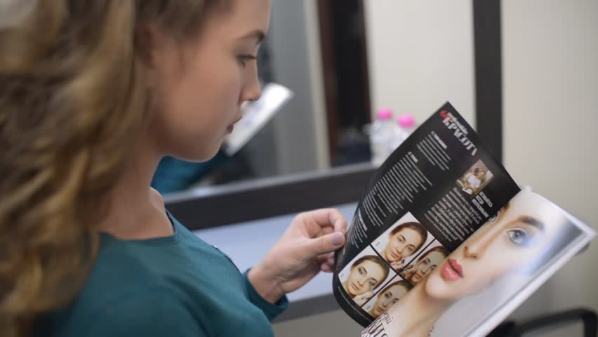
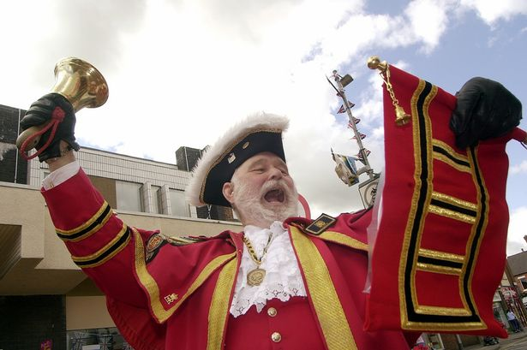
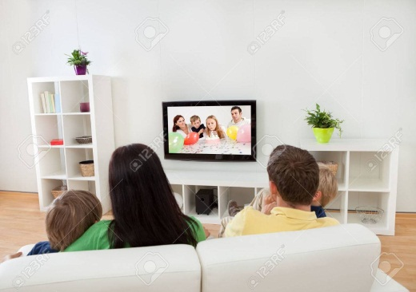
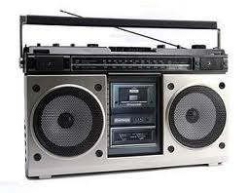

I/ Warm up:
Types of media

Slide 2
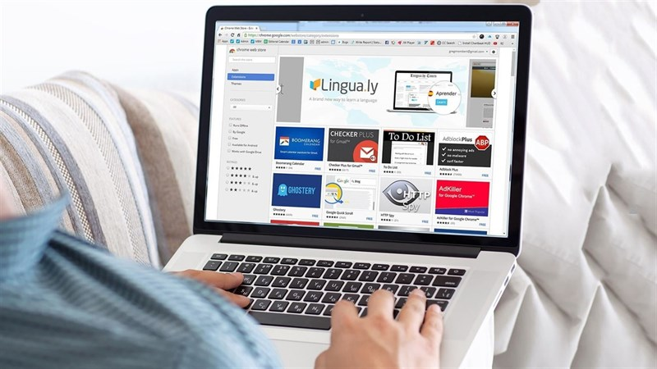
UNIT 5: THE MEDIA
Lesson 4: Read

Slide 3
I. Vocabulary
forum (n):
diễn đàn
deny (v):
phủ nhận
surf (v):
lướt mạng
limitation = disadvantage (n):
hạn chế, bất lợi
time - consuming (adj):
tốn thời gian
spam (n) = junk mail:
thư rác

Slide 4
WHAT AND WHERE
deny
forum
surf
limitation
spam
Time-consuming

Slide 5
Matching
respond (v):
get access to:
purpose (n):
wander (v):
communicate (V):
tiếp cận với
giao tiếp
đi lang thang
mục đích
đáp lại, hưởng ứng
1 e 2 a 3 d 4 c 5 b

Slide 6
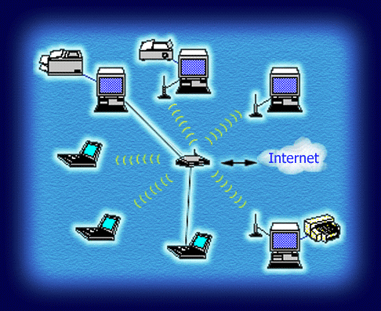
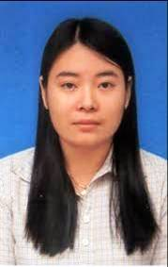
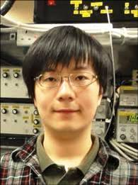
Read the forum on the Internet
Sandra Morgan
Hong Hoa
Huansui
* Pre - Questions:
What does Sandra use the Internet for?
Why is it difficult for Hong Hoa to get access to the Internet?
According toHuansui, why do people use the Internet?

Slide 7
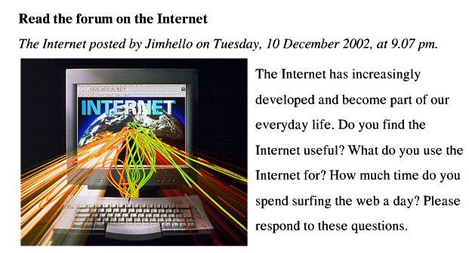
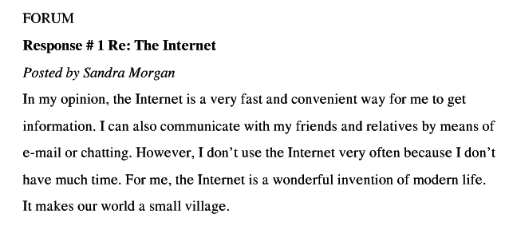

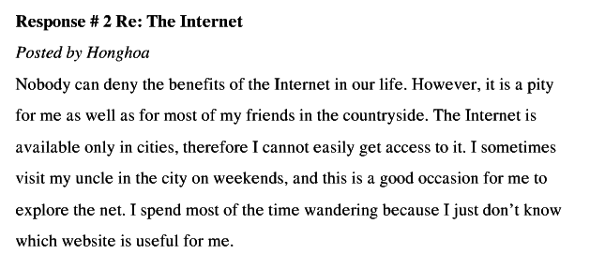
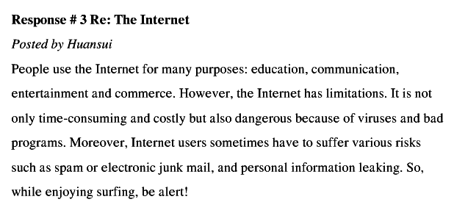

Slide 8
True or false? Find out a mistake and correct the false sentences.
T
1.The Internet is a wonderful invention of modern life.
2.The Internet is a slow and inconvenient way to get information.
3.The Internet is available not only in cities but also in the countries.
4.Bad program is one of the limitations of the Internet.
5.Everyone should be alert when using the Internet.
F
fast and convenient
F
only in cities
T
T

Slide 9

4. What are benefits of the Internet?
5. Are there any disadvantages of the Internet? What are they?
What does Sandra use the Internet for?
Why is it difficult for Hong Hoa to get access to the Internet?
According to Huansui, why do people use the Internet?

Slide 10
* Answer the questions
1. What does Sandra use the Internet for?
- She uses the Internet to get information and communicate with her friends and relatives.
2. Why is it difficult for Honghoa to get access to the Internet?
- Because she lives in the countryside where the Internet is unavailable.
3. According to Huansui, why do people use the Internet?
- People use the Internet for education, communication, entertainment, and commerce.
4. Make benefits of the Internet according to the three responses.
- Benefits: The Internet is used for many purposes: for getting information, communication, education, entertainment and commerce.
5. Are there any disadvantages of the Internet? If so, what are they?
- Yes. There are some disadvantages: time-consuming, costly, dangerous because of viruses and bad programs.
Notes:
10

Slide 11
IV/ POST-READING
6. Do you agree or disagree with the responses?
7. What is your response to this forum ( about the internet)?
The Internet is useful or not?
What ………for?
How much time……………?

Slide 12

Summary
Getting information
Education
Benefits:
Communication
Entertainment
Commerce
Disadvantages:
Time - consuming
Costly
Dangerous because of viruses and bad programs

Slide 13

Homework
1. Learn and write new words.
2. Prepare: Language focus

Slide 14

Question 1
What does Sandra use the Internet for?
02s
03s
04s
05s
06s
07s
08s
09s
10s
01s
A. Getting information
10 gi©y b¾t ®Çu
B. Communicating with friends and relatives.
§· hÕt 10 gi©y
C. Chatting
D. Both A & B correct.

Slide 15
Question 2
Why is it difficult for Hong Hoa to get access to the Internet?
She lives in the countryside, but the Internet is available in the cities.
02s
03s
04s
05s
06s
07s
08s
09s
10s
01s
10 gi©y b¾t ®Çu
§· hÕt 10 gi©y
B. She lives in the city,
C. but the Internet is available in the cities
D. Both B & C correct.

Slide 16
Question 3
According toHuansui, why do do people use the Inetrnet?
For education, and
communication.
02s
03s
04s
05s
06s
07s
08s
09s
10s
01s
10 gi©y b¾t ®Çu
§· hÕt 10 gi©y
B. For getting information, and education
C. For entertainment, and commerce
D. Both A & C correct.

Slide 17
Question 4
What are benefits of the Internet?
Education, communication, entertainment and commerce.
02s
03s
04s
05s
06s
07s
08s
09s
10s
01s
10 gi©y b¾t ®Çu
B. Getting information, education, communication, entertainment and commerce.
§· hÕt 10 gi©y
C. Both A & B uncorrect
D. Both A & B correct.

Slide 18
Question 5
Are there any disadvantages of the Internet? What are they?
Yes, they are time-consuming and costly.
02s
03s
04s
05s
06s
07s
08s
09s
10s
01s
10 gi©y b¾t ®Çu
§· hÕt 10 gi©y
B. No, they are time-consuming and dangerous.
C. yes, they are time-consuming,
costly, and dangerous because of bad programs and viruses.
D. Both A & B correct.

Slide 19
True or False prediction
Key
1.The Internet is a wonderful invention of modern life.
2. Sandra uses the Internet to get information and play games.
3.The Internet is available only in cities, so it is easy for HongHoa to get access to the Internet.
4. According to HuanSui, People use the Internet for only education and getting information.
5. The Internet has not only benefits but also limitations.
Notes:
19
1.The Internet is a slow and inconvenient way to get information. (Sandra)
2.The Internet is available not only in cities but also in the countries.( Hong Hoa)
3.People use the Internet for 2 purposes: education and entertainment. (Huansui)
4.Bad program is one of the limitations of the Internet.
5.Everyone should be alert when using the Internet
1.The Internet is a slow and inconvenient way to get information. (Sandra)
2.The Internet is available not only in cities but also in the countries.( Hong Hoa)
3.People use the Internet for 2 purposes: education and entertainment. (Huansui)
4.Bad program is one of the limitations of the Internet.
5.Everyone should be alert when using the Internet

Slide 20
Read the statements and check your True or False prediction
Key
1.The Internet is a wonderful invention of modern life.
2. Sandra uses the Internet to get information and play games.
3.The Internet is available only in cities, so it is easy for HongHoa to get access to the Internet.
4. According to HuanSui, People use the Internet for only education and getting information.
5. The Internet has not only benefits but also limitations.
T
F
F
F
T
Notes:
1.The Internet is a slow and inconvenient way to get information. (Sandra)
2.The Internet is available not only in cities but also in the countries.( Hong Hoa)
3.People use the Internet for 2 purposes: education and entertainment. (Huansui)
4.Bad program is one of the limitations of the Internet.
5.Everyone should be alert when using the Internet
1.The Internet is a slow and inconvenient way to get information. (Sandra)
2.The Internet is available not only in cities but also in the countries.( Hong Hoa)
3.People use the Internet for 2 purposes: education and entertainment. (Huansui)
4.Bad program is one of the limitations of the Internet.
5.Everyone should be alert when using the Internet

Slide 21


 | Before read | After read | KEY
1.The Internet is a wonderful invention of modern life.
2.The Internet is a slow and inconvenient way to get information.
3.The Internet is available not only in cities but also in the countries.
4.People use the Internet for purposes: education and entertainment,
5.Bad program is one of the limitations of the Internet.
6.Everyone should be alert when using the Internet.
II. Read the statements and decide if the statements are True or False:
T
fast and convenient
F
only in cities
F
communication and commerce
F
T
T
Notes:
1.The Internet is a slow and inconvenient way to get information. (Sandra)
2.The Internet is available not only in cities but also in the countries.( Hong Hoa)
3.People use the Internet for 2 purposes: education and entertainment. (Huansui)
4.Bad program is one of the limitations of the Internet.
5.Everyone should be alert when using the Internet
1.The Internet is a slow and inconvenient way to get information. (Sandra)
2.The Internet is available not only in cities but also in the countries.( Hong Hoa)
3.People use the Internet for 2 purposes: education and entertainment. (Huansui)
4.Bad program is one of the limitations of the Internet.
5.Everyone should be alert when using the Internet

